Slide 1
The technology: tools for learning …
What we need
Programming language
Graphics Support
System Support
Loading/Input/Output
Our choice
JavaScript / WebGL / HTML5
Web-play anywhere!

Slide 2
Development Environment
IDE + Deployment platform (Chrome)
What is an IDE?
Need to make the connection between Chrome and the IDE
GLSL Syntax Checker
JSLint
Eventually: needs a math library
You do need a math library
Read: details of Chapter 1 for installation + working with NetBeans

Slide 3
Chapter 2
The Basics: HTML5, Drawing, and Source Code Organization

Slide 4
This Chapter
Simple drawing with WebGL: constant color square
Variable types: attribute and uniform
Pre-defined variables
Source code files and organization
Approaches to organize: //组织方式
Appreciation for proper abstraction//欣赏抽象？
Approaches to organize source
Support for growth in complexity//复杂
Infrastructure//基础设施 for game engine core
Singleton //？
User code // 用户代码

Slide 5
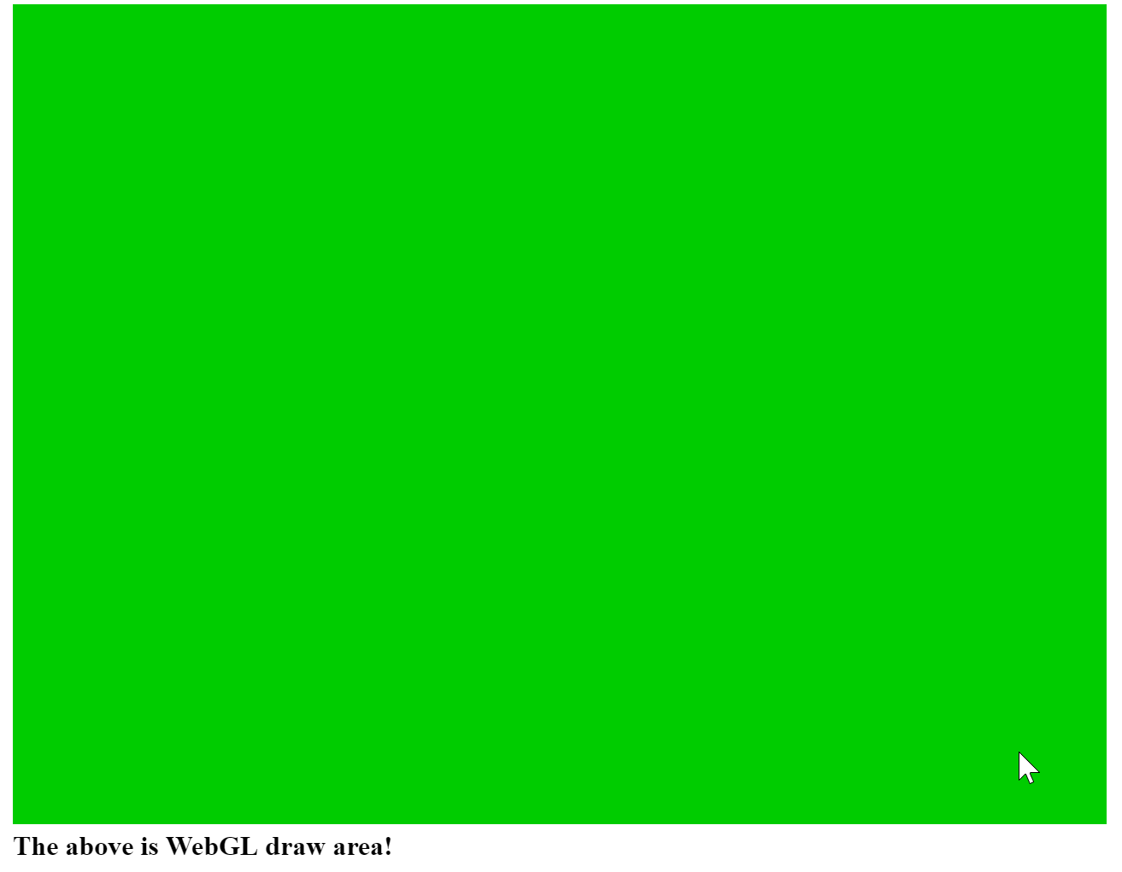
2.1: Canvas for Drawing

Slide 6
2.1: Goals
To learn how to set up the HTML canvas element
To learn how to retrieve // 取回 the canvas element from an HTML document for use in JavaScript
To learn how to create a reference context to WebGL from the retrieved//获取 canvas element and manipulate the canvas from the WebGL context

Slide 7
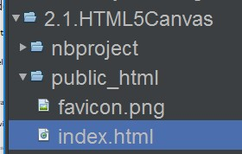
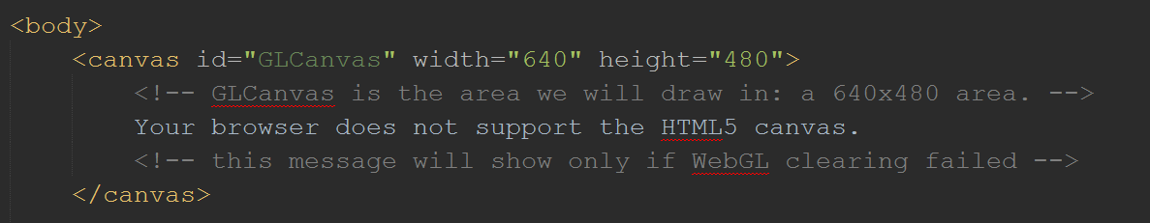
2.1: Define drawing and scripting elements
Create HTML5 Project and edit the index.html file
Define to a drawing canvas (within the <body> element)
Notice the “id”: name of this canvas

Slide 8
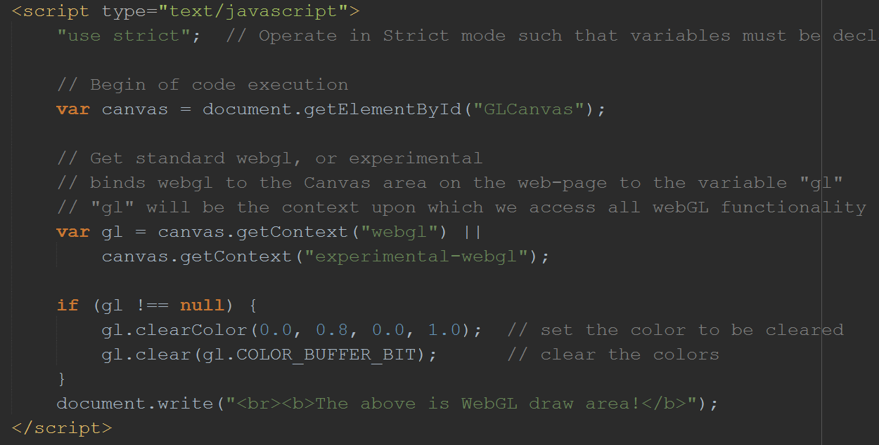
2.1: Scripts for drawing (clearing)
Canvas.getContext指定webgl的绘图方式

Slide 9
2.1: Scripts for drawing (clearing)
Define <script> element

Slide 10
2.1: Scripts for drawing (clearing)
Get drawing canvas by “id”s

Slide 11
2.1: Scripts for drawing (clearing)
Get drawing canvas by “id”s
Get WebGL drawing context (associates WebGL with the drawing area)

Slide 12
2.1: Scripts for drawing (clearing)
Get drawing canvas by “id”s
Get WebGL drawing context (associates WebGL with the drawing area)
Draws (clears) with the WebGL context

Slide 13
2.1: Summary
Define a drawing element (with <canvas> tag)
Define scripting element (with <script> tag)
Get a reference to the drawing area
Associate a WebGL context with the drawing area
Draw (in our case) clear with the WeblGL context
Lesson:
Define area
Associate context with area
Draw with context (by using code: gl.Something)

Slide 14

2.2: Source code organization
Observations:
Index.html: contains both
Web page rendering HTML tags
E.g. <body>
Program Logic flow
E.g.
Problem:
One file contains contents for heterogeneous purposes//异类？
Does not support growth in complexity!

Slide 15
2.2: Goals
To learn how to separate source code into different files
To organize your code in a logical structure

Slide 16
2.2: Steps
Define source code file(s)
Include source code file in HTML contents
Invoke source code logic//调用逻辑

Slide 17
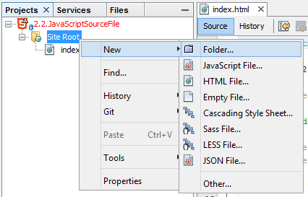
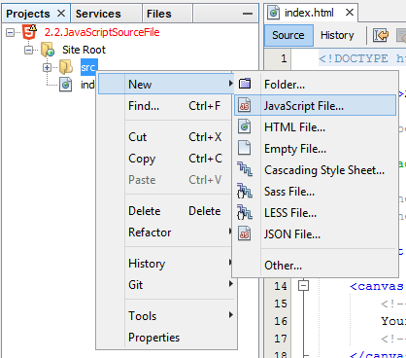
2.2: Define source code file(s)
Create new folder
for organization purposes
Create new source code file in the folder
Name: WebGL.js

Slide 18
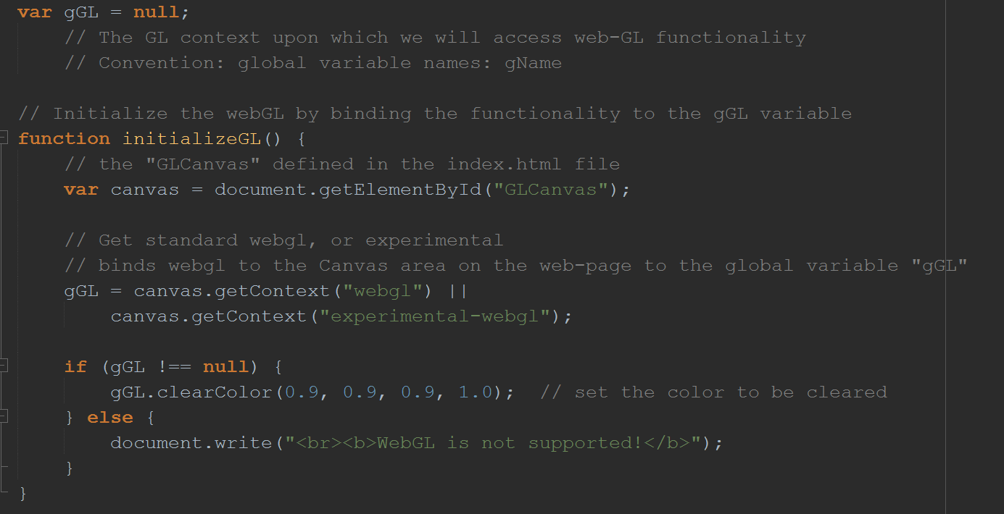
2.2: Define source code: in WebGL.js

Slide 19
2.2: Define source code: in WebGL.js
A global variable

Slide 20
2.2: Define source code: in WebGL.js
A global variable
Convention:
Global variable names begins with “g”

Slide 21
2.2: Define source code: in WebGL.js
A global variable
Define a new function

Slide 22
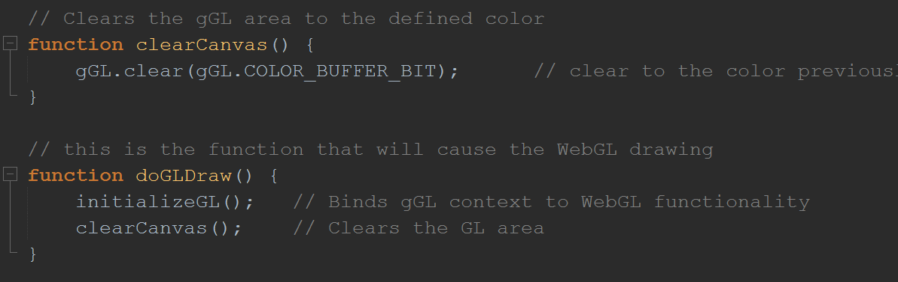
2.2: More source code definition
Functions defined
Now, must invoke the execution

Slide 23
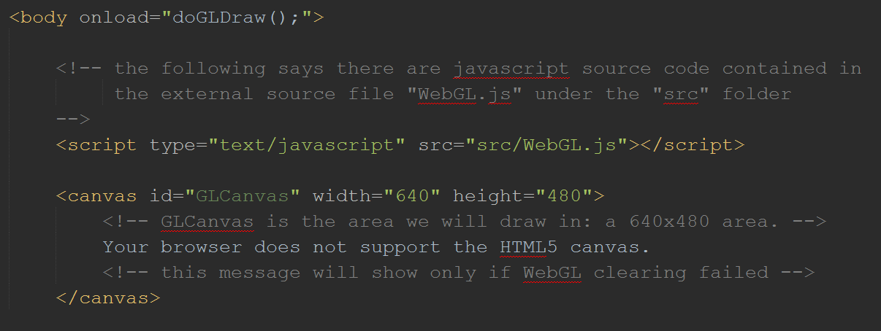
2.2: Include and Invoke source Code
Index.html

Slide 24
2.2: Include and Invoke source Code
Index.html
Include the source code

Slide 25
2.2: Include and Invoke source Code
Execute when <body> element is loaded (when </body> is encountered)//遇到Body结束标签
Index.html
Include the source code

Slide 26
Elementary Drawing with WebGL
Drawing with WebGL is non-trivial in general
Involves:
New processor (GPU)
New programming language: GLSL
Steps:
Define geometry
Load geometry (to GPU)
Define drawing program (in GLSL)
Load and compile drawing program (to GLSL)
Invoke drawing from Javascript

Slide 27

2.3: Draw One Square

Slide 28
2.3: Goals
To understand how to load geometric data to the GPU
To learn about simple GLSL shaders for drawing with WebGL
To learn how to compile and load shaders to the GPU
To understand the steps to draw with WebGL

Slide 29
2.3: Steps
Define and load geometry (to GPU)
定义和加载几何图形
Define drawing program (in GLSL)
定义绘制程序
Load, Compile, Link, drawing program (to GLSL)
加载，编译，连接，绘制程序
Bind drawing program with geometry
捆绑绘画程序和几何图形
Invoke drawing from Javascript
通过js调用drawing

Slide 30
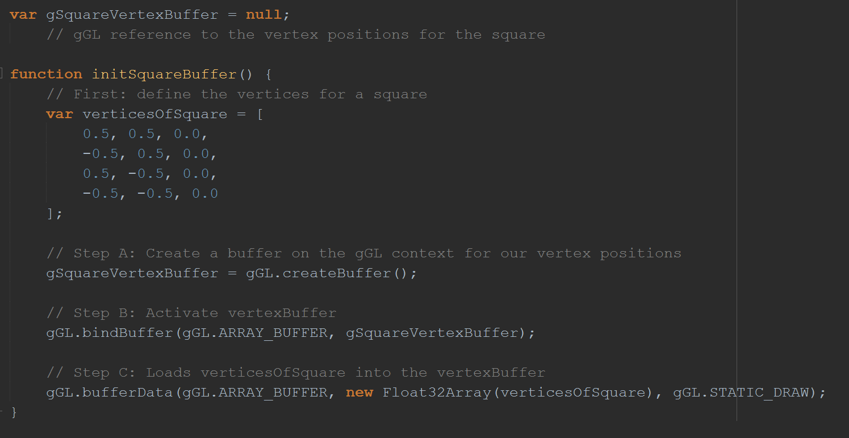
2.3: Define geometry
VertexBuffer.js/顶点缓冲区

Slide 31
2.3: Define geometry
Global variable to keep track of WebGL Vertex Buffer
VertexBuffer.js

Slide 32
2.3: Define geometry
Global variable to keep track of WebGL Vertex Buffer
VertexBuffer.js
Convention:
Notice the global variable name …

Slide 33
2.3: Define geometry
Global variable to keep track of WebGL Vertex Buffer
VertexBuffer.js
Unit square at origin on the X/Y plane [defined in CPU memory here]

Slide 34
2.3: Define geometry
Global variable to keep track of WebGL Vertex Buffer
VertexBuffer.js
Create buffer in GPU
Bind the created buffer to the global variable
Load the unit square definition from the CPU to GPU memory

Slide 35
2.3: Define GLSL drawing program
For now (must change later), define program in index.html
Remember: <script> element and id for an element

Slide 36
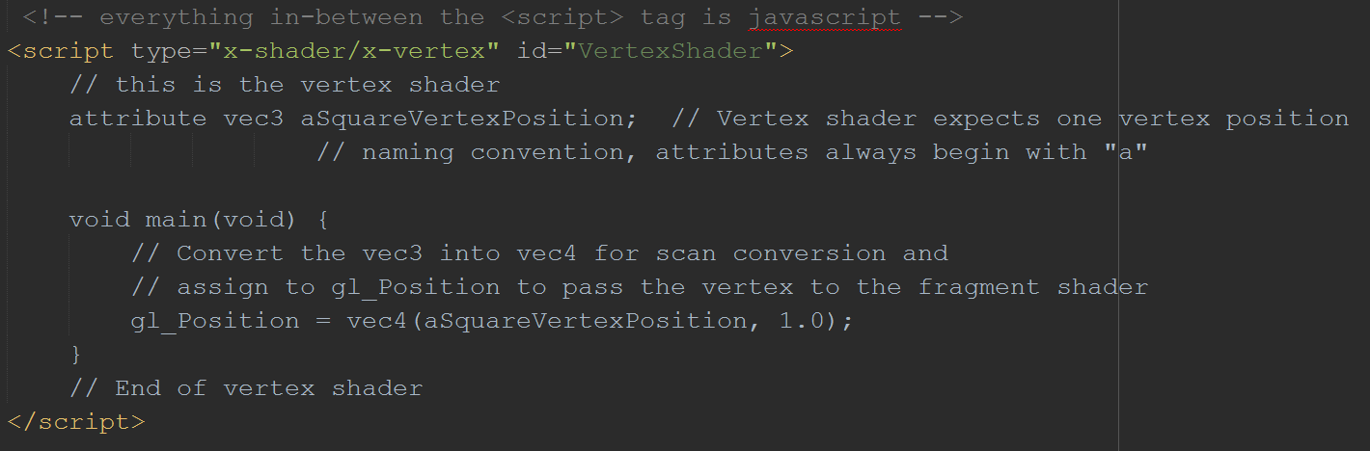
2.3: Define GLSL drawing program
VertexShader: called by WebGL per each vertex
Index.html

Slide 37
2.3: Define GLSL drawing program
<script> element
VertexShader: called by WebGL per each vertex

Slide 38
2.3: Define GLSL drawing program
<script> element
Id of element
VertexShader: called by WebGL per each vertex

Slide 39
2.3: Define GLSL drawing program
VertexShader: called by WebGL per each vertex
Parameter for “binding” program to specific geometry

Slide 40
2.3: Define GLSL drawing program
VertexShader: called by WebGL per each vertex
The VertexShader program:
VERY simple
gl_Position: defined by WebGL

Slide 41
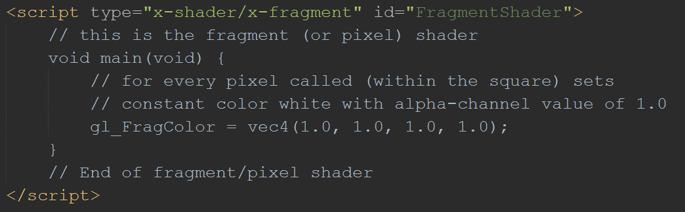
2.3: Define GLSL drawing program
FragmentShader: called by WebGL per each vertex
Index.html

Slide 42
2.3: Define GLSL drawing program
FragmentShader: called by WebGL per each vertex

Slide 43
2.3: Define GLSL drawing program
FragmentShader: called by WebGL per each vertex
The FragmentShader program:
VERY simple
gl_FragColor: defined by WebGL
Always output white (1.0) ➔ White square

Slide 44
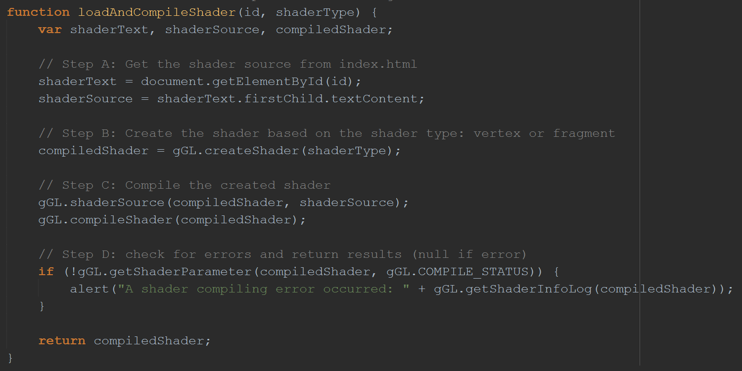
2.3: Load, Compile, Link, GLSL programs
loadAndCompileShader(): load (CPU to GPU) and compile
ShaderSupport.js

Slide 45
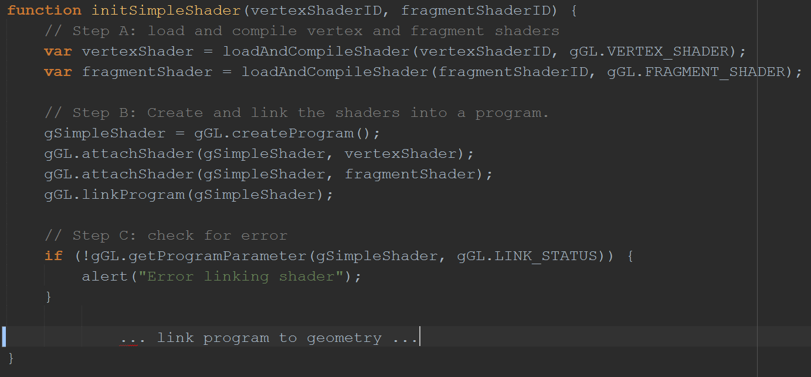
2.3: Load, Compile, Link, GLSL programs
ShaderSupport.js
initSimpleShader(): Load/Compile

Slide 46
2.3: Load, Compile, Link, GLSL programs
ShaderSupport.js
initSimpleShader(): Load/Compile
Call the load function twice, once for each Vertex and Fragment shader program

Slide 47
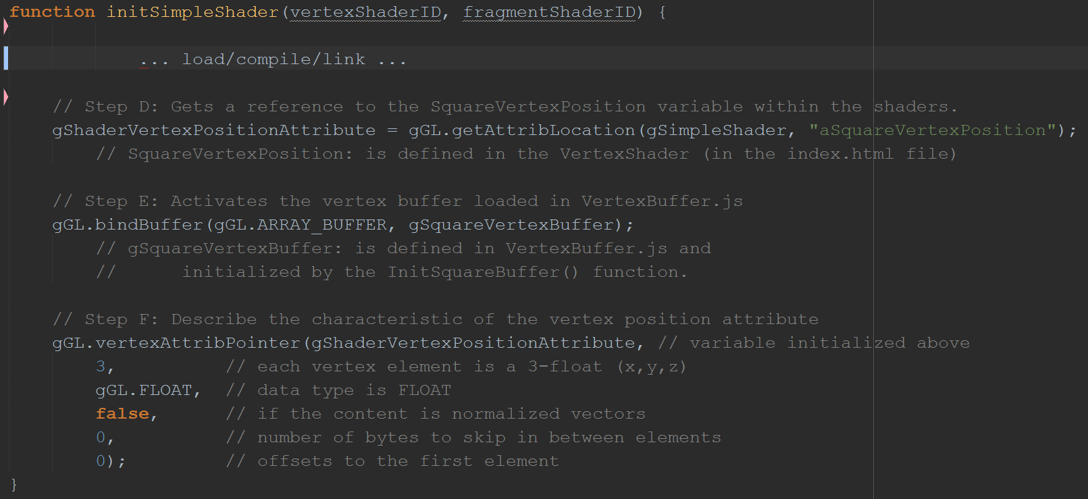
2.3: Load, Compile, Link, GLSL programs
Bind program to geometries (the unit square)
ShaderSupport.js

Slide 48
2.3: Load, Compile, Link, GLSL programs
Bind program to geometries (the unit square)
ShaderSupport.js
The parameter defined in VertexShader

Slide 49
2.3: Load, Compile, Link, GLSL programs
Bind program to geometries (the unit square)
ShaderSupport.js
The parameter defined in VertexShader
The WebGL buffer containing the loaded unit square (defined in VertexBuffer.js)

Slide 50
2.3: Load, Compile, Link, GLSL programs
Bind program to geometries (the unit square)
ShaderSupport.js
The parameter defined in VertexShader
The WebGL buffer containing the loaded unit square (defined in VertexBuffer.js)
Binding the buffer (unit square vertices) to the parameter (vertex of VertexShader): binding geometry to the GLSL vertex shader program

Slide 51
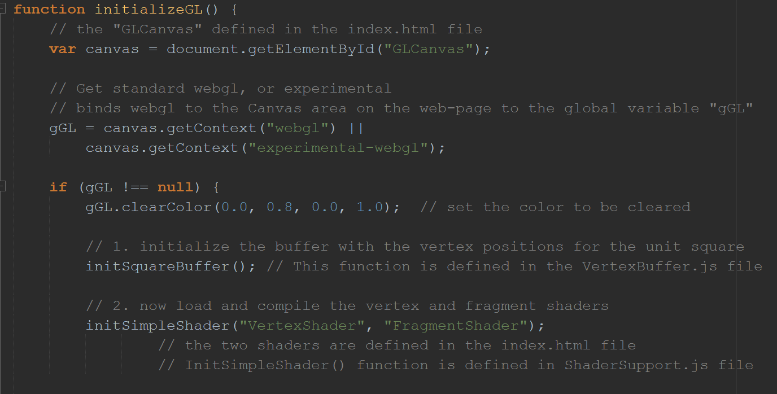
2.3: Invoke the WebGL drawing
WebGL.js
Define unit square and load to GPU (in VertexBuffer.js)
Load, compile, GLSL programs and bind to the unit square geometry (in ShaderSupport.js)

Slide 52
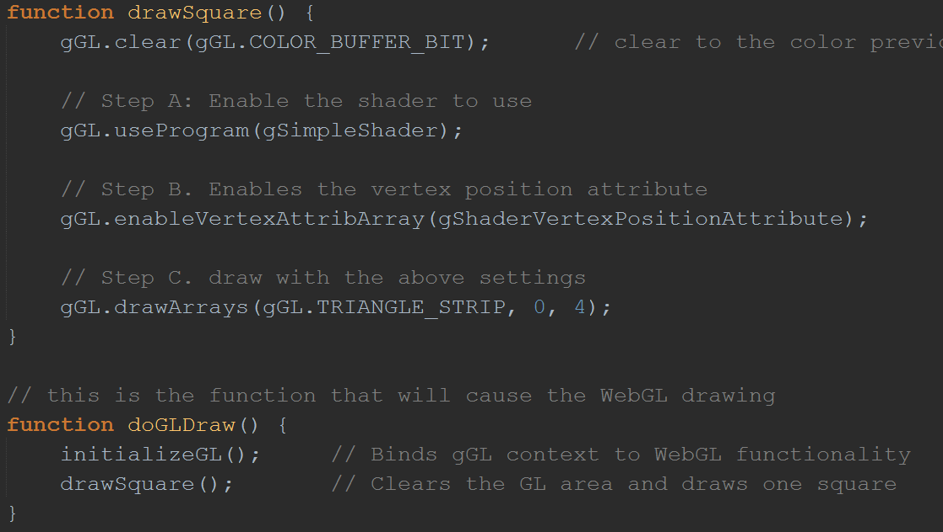
2.3: Invoke the WebGL drawing
WebGL.js
Clear
Select drawing program
Activate geometry
Draw as triangle strips with 4 vertices

Slide 53
2.3: Invoke the WebGL drawing
WebGL.js
Called from index.html (when <body> is completed loaded)

Slide 54
2.3: Observations
NOT a square:
The default Normalized Device Coordinate (NDC)
(-1, -1) to (1, 1)
Square space mapped to non-square drawing area
640x480 canvas area
How to change color of the square?
Problems:
Many global variables scattered //疏散？回收？ in different files (is this a problem?)
Fix in the next example
How to draw more than one square?
Fix in the next chapter!

Slide 55
2.4: JavaScript Objects Project
Draw one square project:
Functional decomposition//功能分解
Procedural programming//程序化编程
Define procedures/functions to support the logic flow
Well-structured, easy to understand
Does not support hiding of information or increase in complexity
This project:
Object-oriented analysis and programming
Isolates and hides details
Support: manageability and expandability

Slide 56
2.4: Goals
To separate the game engine from the game logic code
To demonstrate the implementation of a Singleton-like//？ object based on the JavaScript Module pattern
To understand how to build abstractions with JavaScript objects

Slide 57
2.4 Steps
Separate folder to organize source code
Separate game engine into
Core, VertexBuffer, and SimpleShader
Define “user” code
User of GameEngine

Slide 58
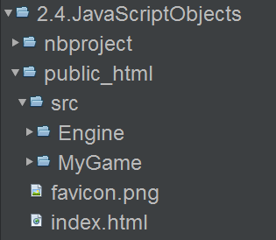
2.4: Folder organization
Source code folders:
Engine: source code to the game engine
MyGame: user code

Slide 59
2.4: Folder organization
Source code folders:
Engine: source code to the game engine
MyGame: user code

Slide 60
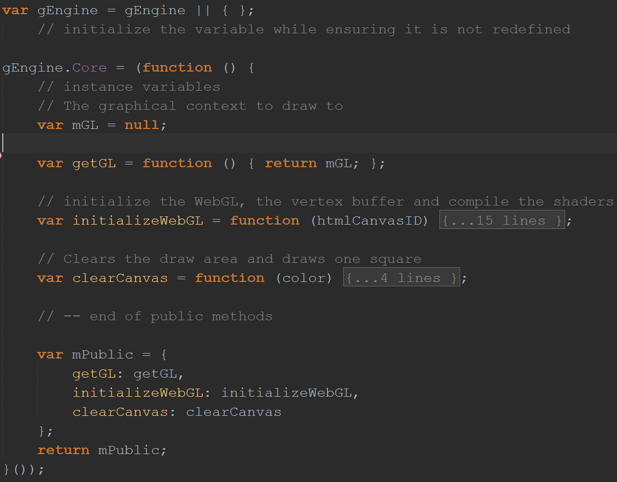
2.4: Abstracting the Game Engine Core
Engine_Core.js

Slide 61
2.4: Abstracting the Game Engine Core
Engine_Core.js
Global singleton!
Publically accessible members

Slide 62
2.4: Abstracting the Game Engine Core
Engine_Core.js
Global singleton!
Look at this …
Publically accessible members

Slide 63
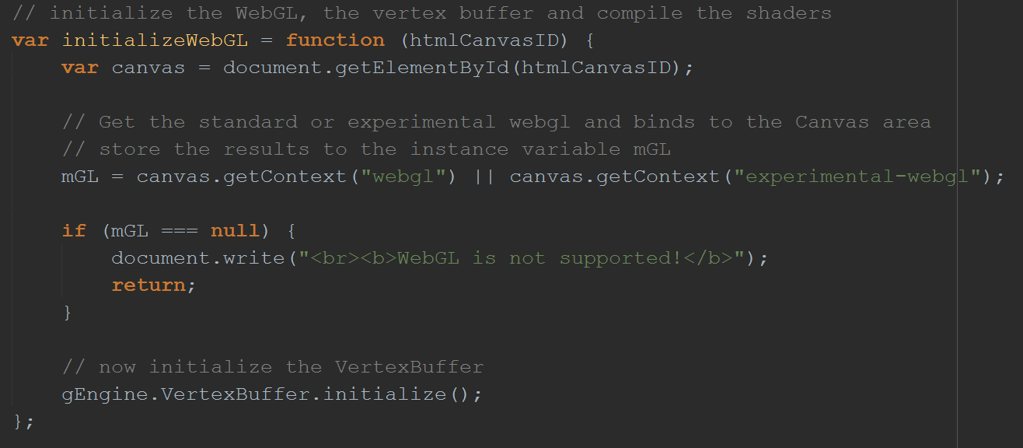
2.4: Abstracting the Game Engine Core
Engine_Core.js
Global singleton!
Look at this …
Publically accessible members

Slide 64
2.4: Abstracting the Game Engine Core
Engine_Core.js
Global singleton!
Look at this …
What’s this?
Publically accessible members

Slide 65
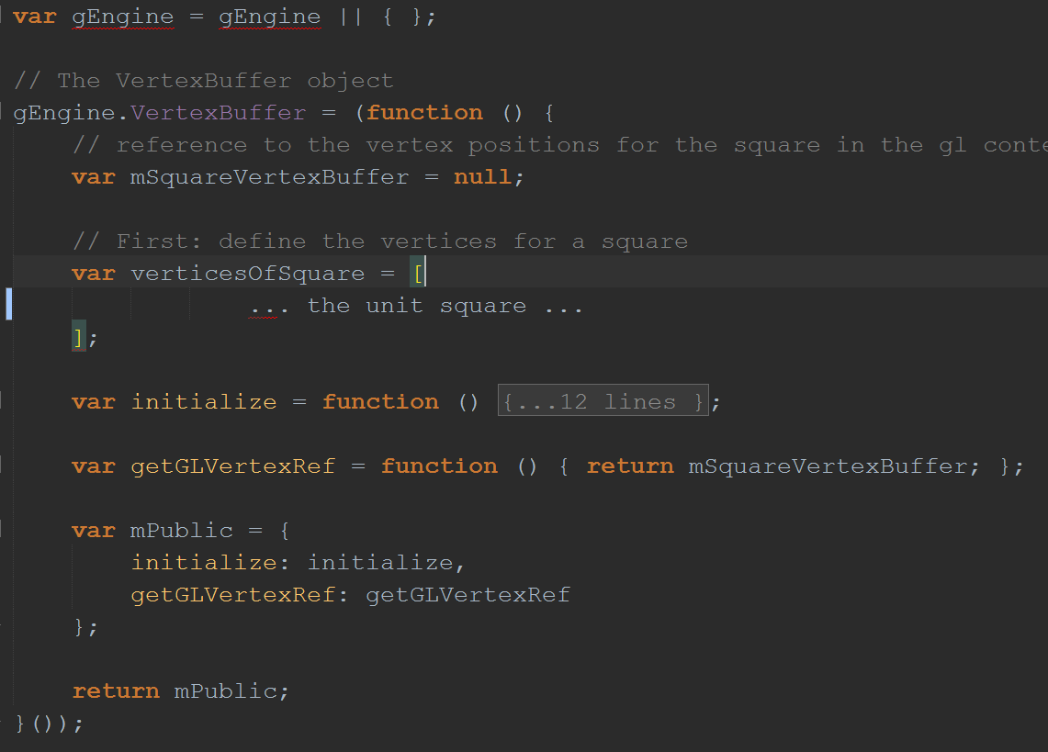
2.4: Abstracting the VertexBuffer
Engine_VertexBuffer.js

Slide 66
2.4: Abstracting the VertexBuffer
Engine_VertexBuffer.js
Recall …

Slide 67
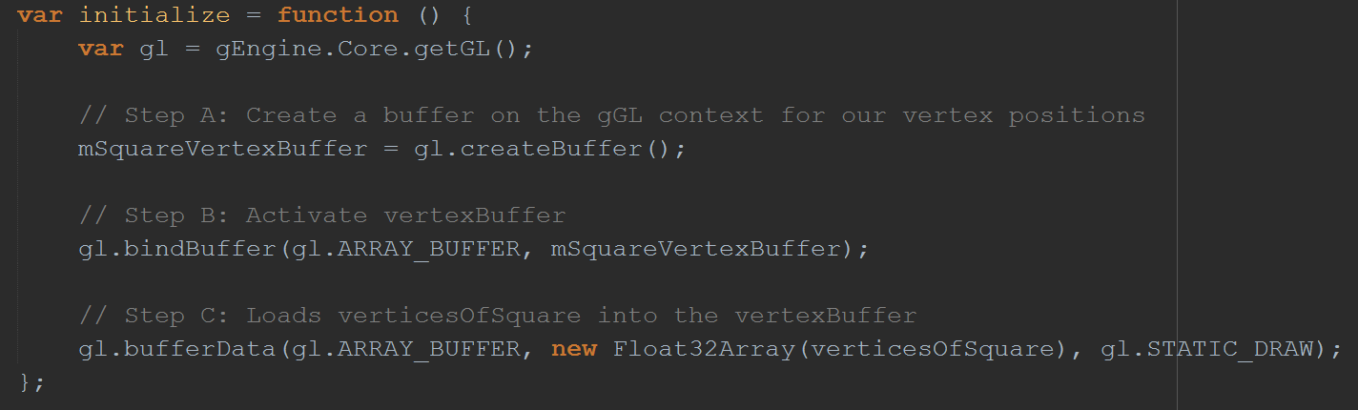
2.4: Abstracting the VertexBuffer
Create WebGL buffer
Store buffer reference in mSquareVertexBuffer
Load unit square vertices to this buffer
Recall …

Slide 68
2.4: Abstracting the VertexBuffer
Create WebGL buffer
Store buffer reference in mSquareVertexBuffer
Load unit square vertices to this buffer
Recall …
Public access to:
Initialize() function and
The WebGL vertex buffer (for binding to GLSL vertex program)

Slide 69
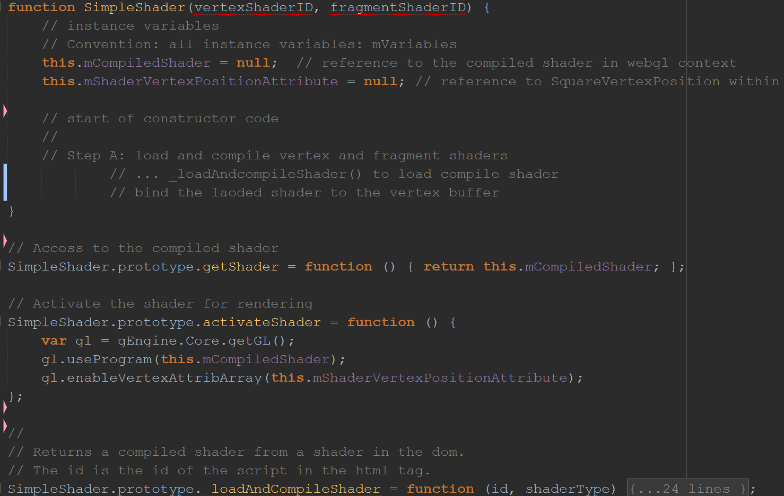
2.4: The SimpleShader object
SimpleShader.js

Slide 70
2.4: The SimpleShader object
Constructor of SimpleShader object
Notice the instance variables

Slide 71
2.4: The SimpleShader object
Constructor of SimpleShader object
Notice the instance variables
Convention:
Instance variable names … begins with “m”
Private functions (not enforced by JavaScript), names begin with “_”

Slide 72
2.4: The SimpleShader object
Constructor of SimpleShader object
Notice the instance variables
Activate the shader
Bind to the unit square vertex

Slide 73
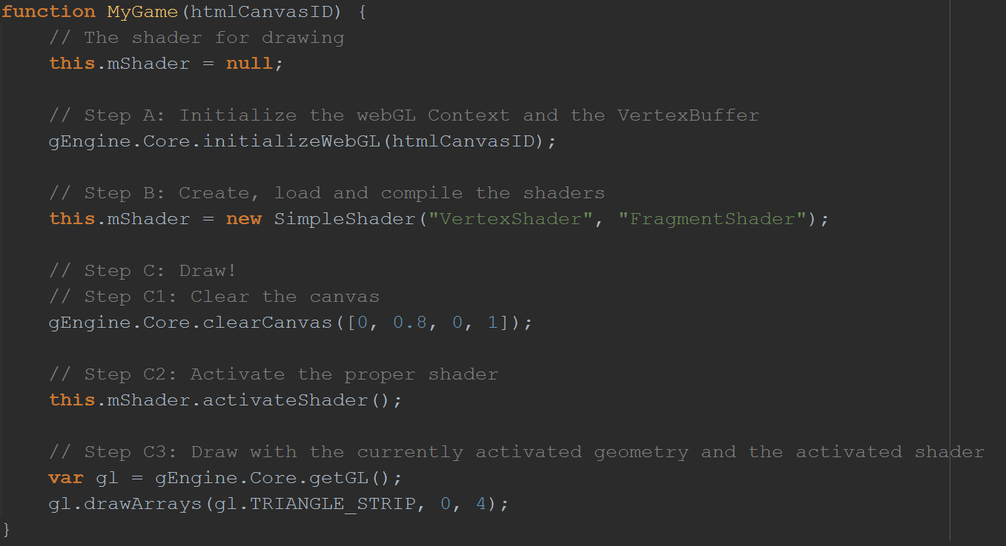
2.4: The Client (User) code
Client of the game engine: the game … in MyGame folder
MyGame.js

Slide 74
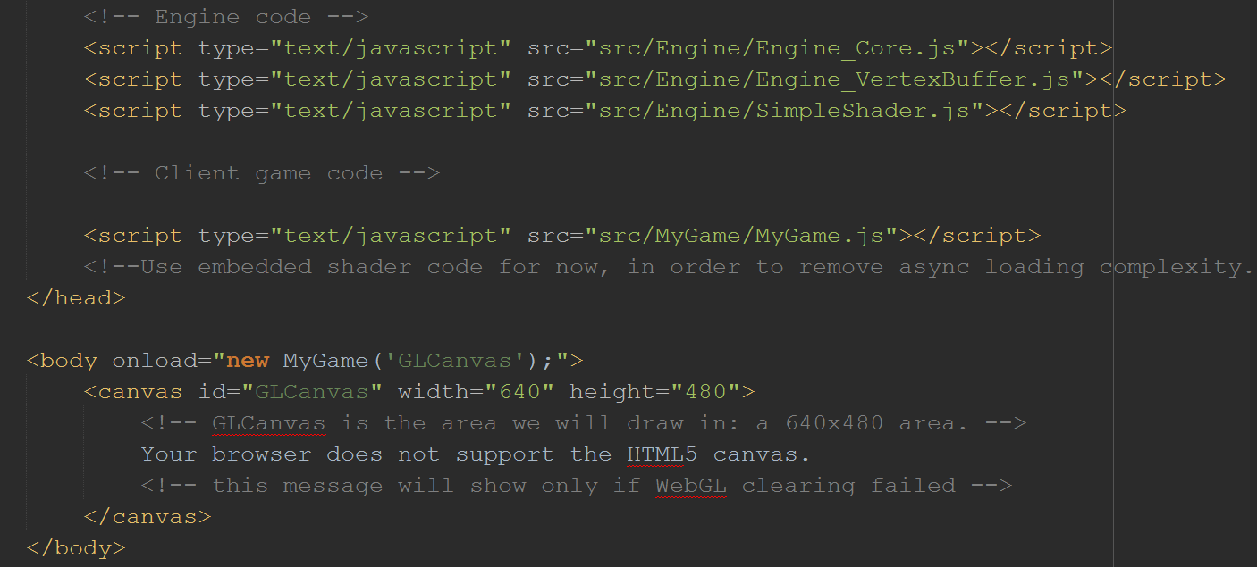
2.4: invoking MyGame from index.html

Slide 75
2.4: invoking MyGame from index.html

Slide 76
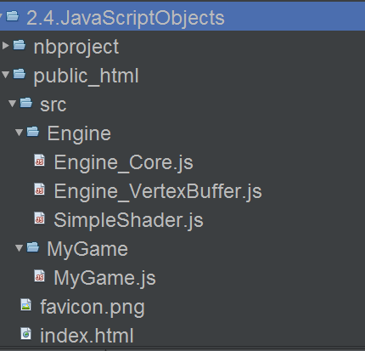
2.4: Observation
Organization:
Engine: Source code to game engine
Engine_Core:
core of engine
Engine_VertexBuffer:
unit square buffer
SimpleShader:
the shader that supports drawing
MyGame: Client code

Slide 77
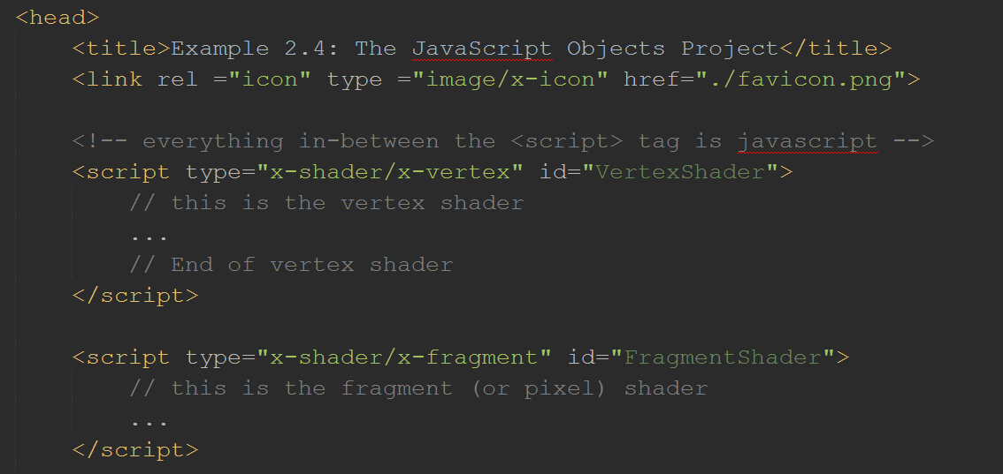
2.5: Separating GLSL shader source code
Recall: GLSL shaders are defined in index.html

Slide 78
2.5: Separating GLSL shader source code
Recall: GLSL shaders are defined in index.html

Slide 79
2.5: Goals
To separate the GLSL shaders from the HTML source code
To demonstrate how to load the shader source files during runtime

Slide 80
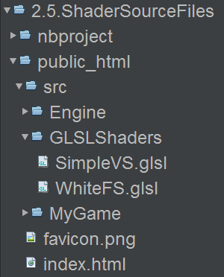
2.5: Organization
Creare a new folder

Slide 81
2.5: Organization
Creare a new folder
GLSLShader
Storing GLSL shaders
Our own convension
SimleShaderVS
SimpleShaderFS

Slide 82
2.5: Organization
Creare a new folder
GLSLShader
Storing GLSL shaders
Convention:
VS: for Vertex Shader: SimpleVS
FS: for Fragment Shaders:WhiteFS

Slide 83
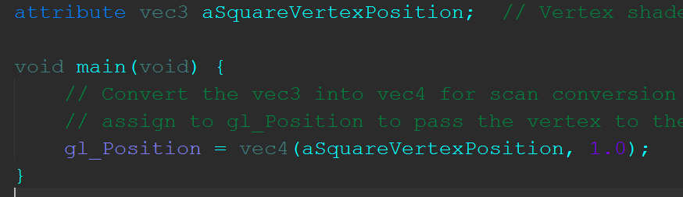
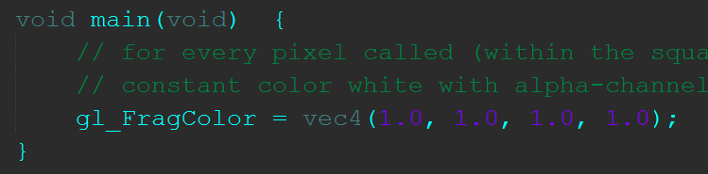
2.5: GLSL Source Code
SimpleVS.glsl
WhiteFS.glsl

Slide 84
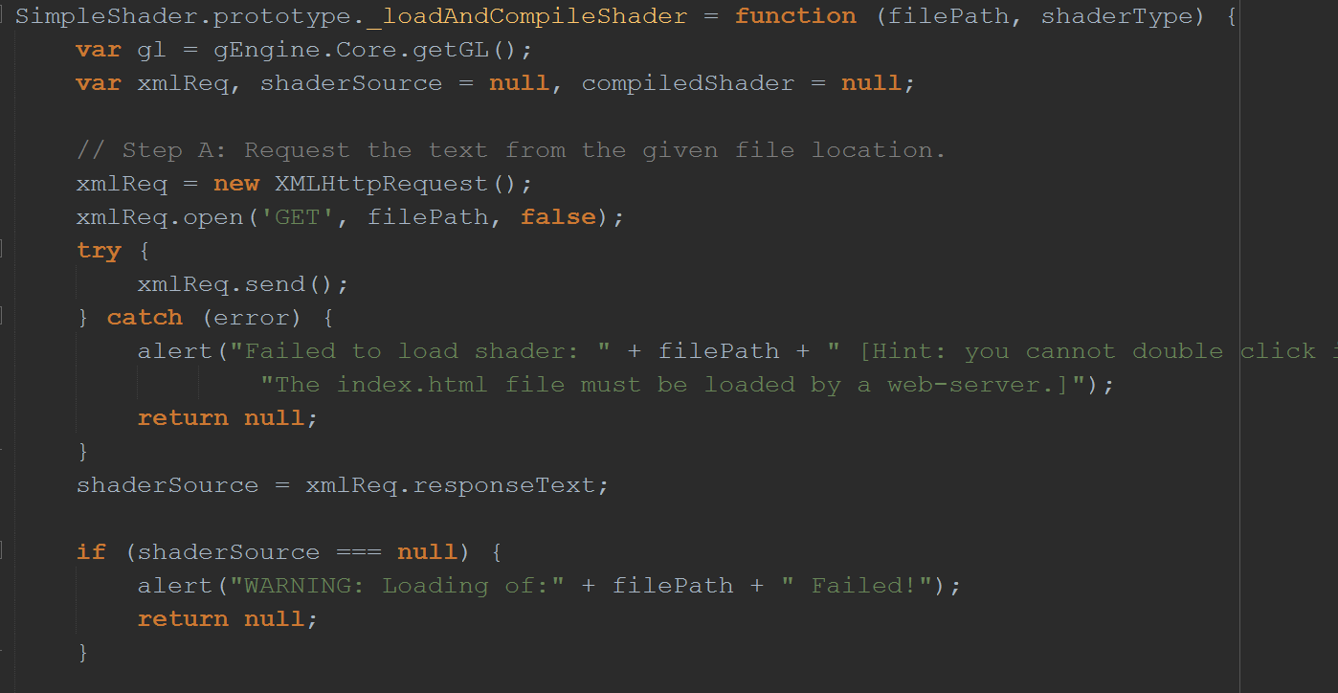
2.5: Runtime Sync Loading of GLSL files

Slide 85
2.5: Runtime Sync Loading of GLSL files

Slide 86
2.5: Runtime Sync Loading of GLSL files
Warning: cannot double click on index.html on your machine to run (unless you have a server running and properly configured your system).

Slide 87
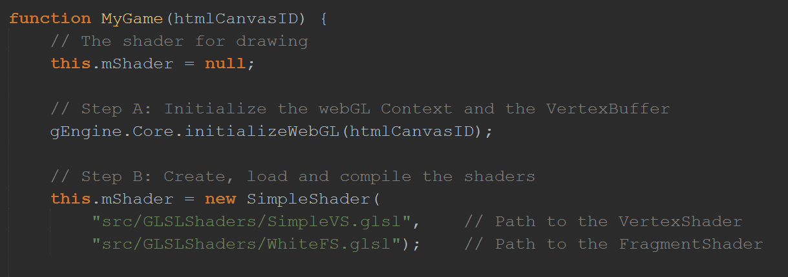
2.5: Invoking the loading from MyGame

Slide 88
2.5: Invoking the loading from MyGame

Slide 89
2.5: Problem
Synchronous load: performance problem!
Issue load and wait … fix later (when learn about resource management)

Slide 90
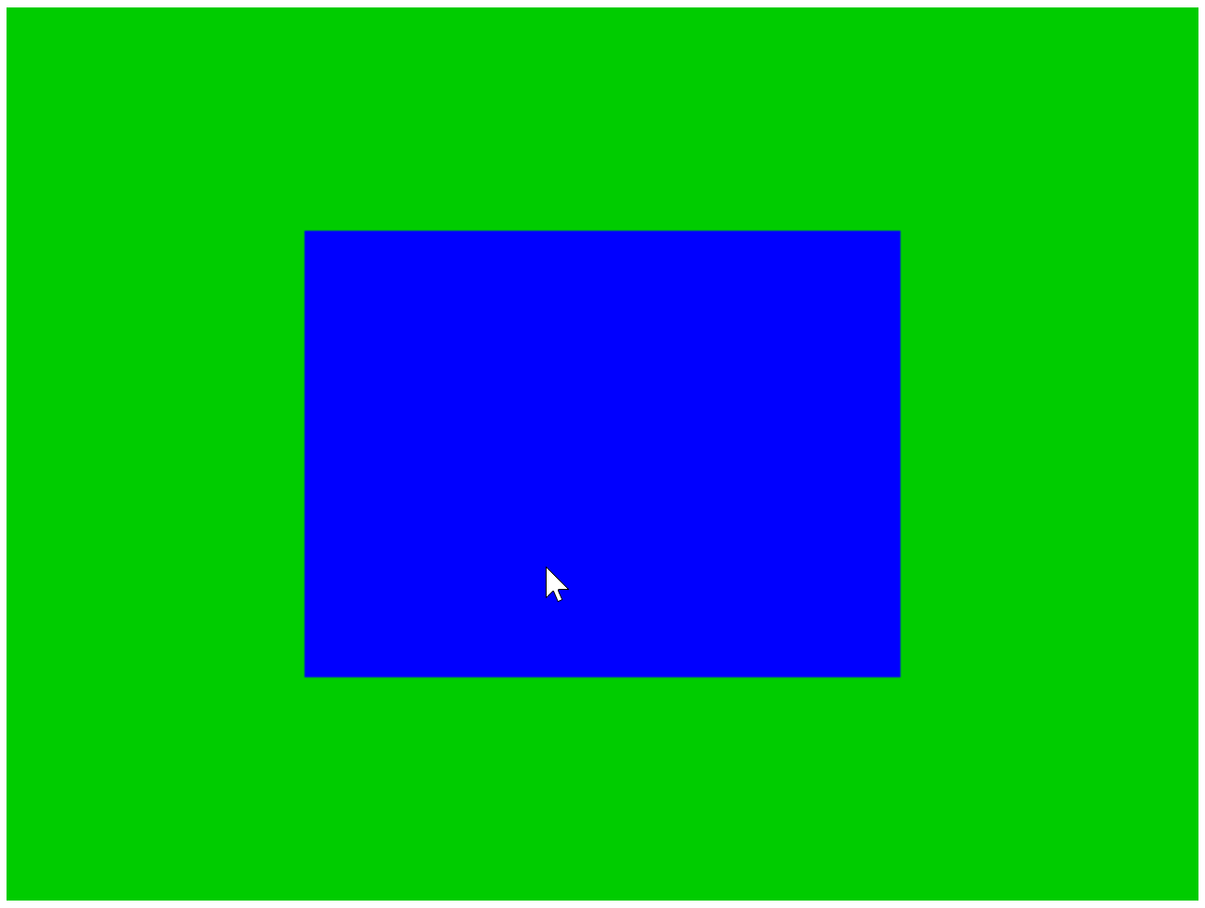
2.6 Parameterize Fragment Shader

Slide 91
2.6: Goals
To gain experience with creating a GLSL shader in the source code structure
To learn about the uniform variable and define a fragment shader with the color parameter

Slide 92
2.6: Attribute …
Recall “attribute variable” in vertex shader
Binds per vertex
SimpleVS.glsl

Slide 93
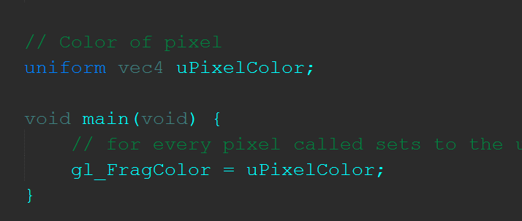
2.6: Uniform …
Bind once per loading of the shader …
Add in “uniform” and change WhiteFS to SimpleFS
SimpleFS.glsl

Slide 94
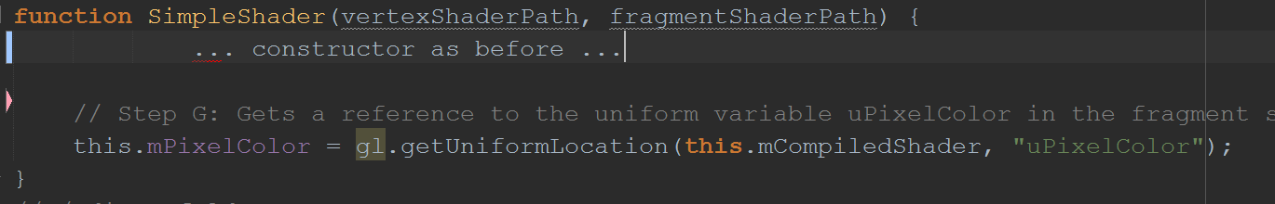
2.6: Drawing with the new shader …
SimpleShader.js
Constructor of SimpleShader object
Keep a reference to the uniform variable defined in SimpleFS

Slide 95
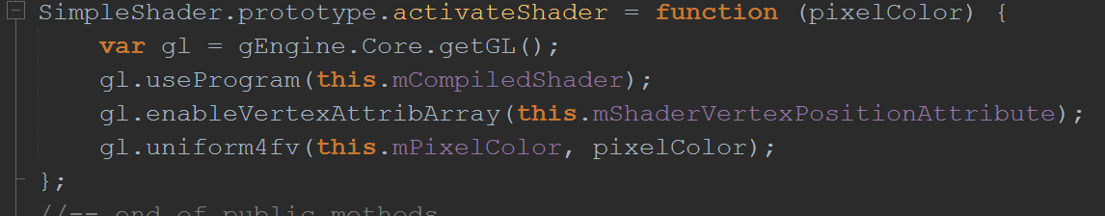
2.6: Drawing with the new shader …
SimpleShader.js
Constructor of SimpleShader object
Keep a reference to the uniform variable defined in SimpleFS

Slide 96
2.6: Drawing with the new shader …
SimpleShader.js
Constructor of SimpleShader object
Keep a reference to the uniform variable defined in SimpleFS
Allow binding the uniform location to parameter when activate (same value for the entire drawing)

Slide 97
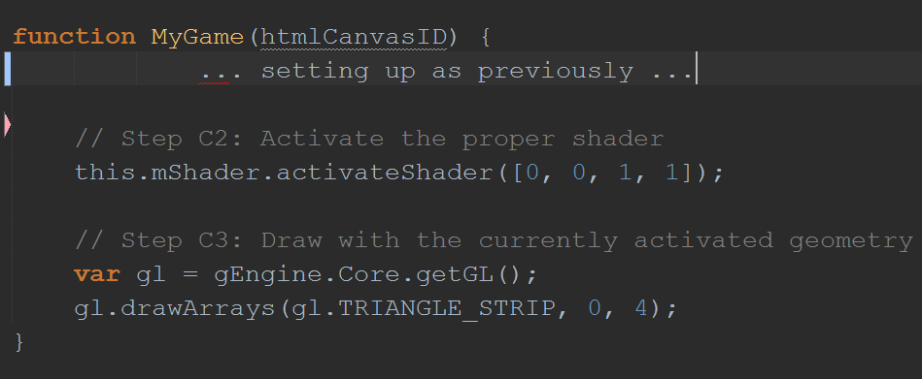
2.6: Drawing with the new shader …
Activate with specific color in MyGame
MyGame.js

Slide 98
Chapter 2: Learned?
Development with HTML, WebGL, and Javascript
Importance of source code organization
Folders
Source code file types: html, js, glsl
Object-orientation analysis and implementation
GLSL:
Programming model: memory loading, program compiling
attribute and uniform variables
Predefined: gl_Positoin, gl_FragColor

Slide 99
Today: work on EX1

